Slide 1
Automatic Summarization of Presidential Candidates’ Debate Platform
Rodrick Leary

Slide 2
Final Capstone
This dataset corresponds to final part of the Thinkful Data Science Program. You can visit this notebook at

Slide 3
Outline
Introduction
Dataset Information
Dataset Analysis and Exploration
Feature Engineering
Testing and Evaluation

Slide 4
Introduction

Slide 5
We’ll explore and model a dataset from comprised by rev.com, a website that specializes in providing transcription data.
By optimizing presidential debate coverage, we can use this information to optimize debate and presidential campaign coverage.
This dataset contains information regarding debate location, speaker, speaker comments, and speaking time.
My objective is to find the most representative sentence in each candidate’s debate responses.

Slide 6
Dataset Information

Slide 7
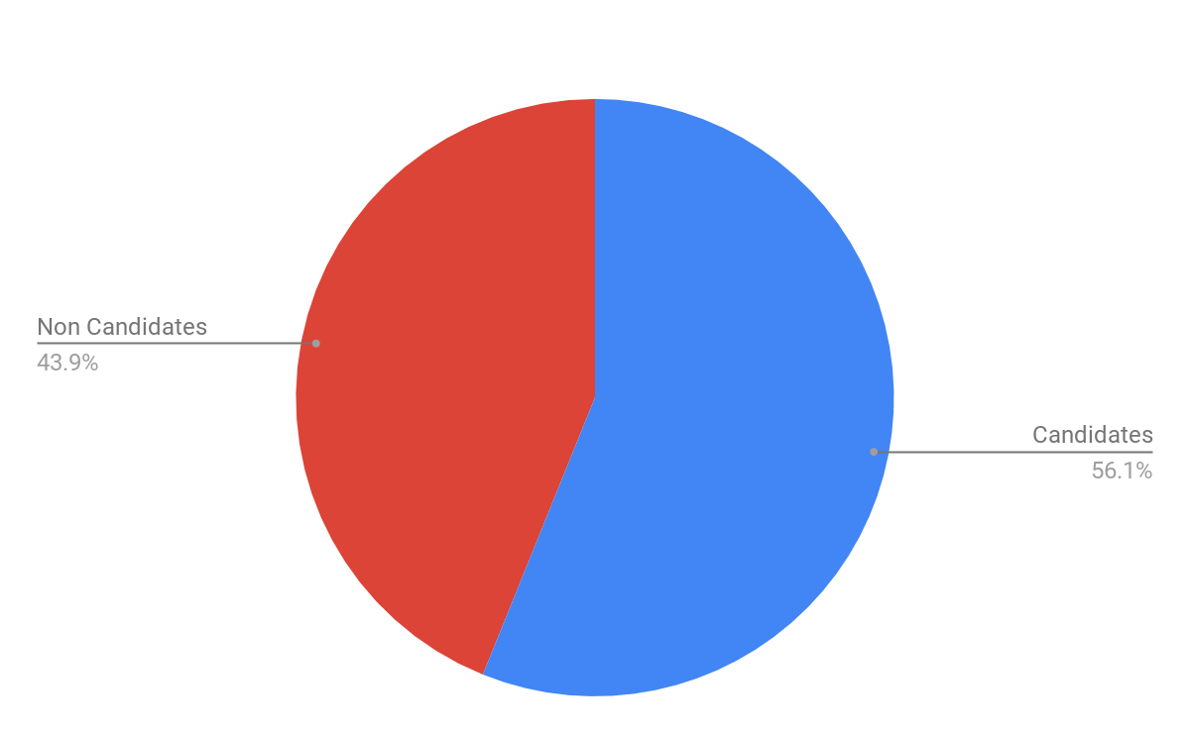

Slide 8
Dataset Information
Dataset excluded the 2594 comments that were made by individuals who were not presidential candidates.

Slide 9
Dataset Exploration

Slide 10
Number of Presidential Candidates
There were 20 Democratic Presidential Candidates whose data was included in these data.

Slide 11
Speaking Time
Average Comment Length for Presidential Candidates = 14 seconds
Concentrated between 2 and 25 seconds.
Candidate with most comments and longest total speaking was Joe Biden.
Candidate with the highest median speaking time was Andrew Yang.

Slide 12
Feature Engineering

Slide 13
Cleaned spelling Errors in Candidate Names
Performed standard text cleaner on the comments.
Parsed and tokenized the text.

Slide 14
Testing and Evaluation

Slide 15
Extractive Text Summarization Model
TextRank Algorithm
Returned most representative sentence for each candidate

Slide 16
Example
Bernie Sanders: “The answer is if we have the guts that I would like to see the Democratic have that guts, to stand up to the drug companies, and the insurance companies, and tell them that the function of healthcare is the guaranteed care to all people.

Slide 17
Keyword Summarization Model
Calculate Neighbors of Words
Run TextRank algorithm on Adjacency Dictionary

Slide 18
Example
Bernie Sanders: “People”, “Miles”, “Honest”, “World”, “Candidate”

Slide 19
Best Model for Representing Candidates Debate Comments
Extractive Text Summarization Model

Slide 20
How Can This Information Help Us
Allows news media to keep individuals more up-to-date during election season.
Allows campaigns to simplify their message to reach a larger audience.
Allows us to reach individuals who consume news in shorter doses and may not be interested in the traditional news format.

Slide 21
How Can We Improve Our Model
Hyperparmeter Tuning
Developing an abstractive text model
Developing more statistics based measures of evaluation for text-based data models.

